Slide 1
From evidence to causes
The book of Why
(Chapter 3)

Slide 2
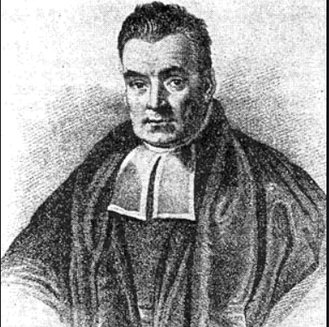
BAYES AND THE PROBLEM OF INVERSE PROBABILITY
Thomas Bayes in 1750s!!!
Analysis of the “Inverse probability” = Estimate the probability of a cause knowing the effect.
(Forward Probability = Estimate the probability of an effect knowing the cause).
Essay towards solving a problem in the doctrine of chances published in the Philosophical Transactions of the Royal Society of London in 1764. The paper was sent to the Royal Society by Richard Price, a friend of Bayes’.
1702-1761

Slide 3
BAYES AND THE PROBLEM OF INVERSE PROBABILITY
Pool table example (1763): We shoot a billiard ball in a table…
Forward probability = What is the probability the ball will stop within 1 foot (x) of the end of the table of length 12 (L).
P(x|L) = x/L = 1/12 = 0.08333

Slide 4
BAYES AND THE PROBLEM OF INVERSE PROBABILITY
Pool table example (1763): We shoot a billiard ball in a table…
Forward probability = What is the probability the ball will stop within 1 foot (x) of the end of the table of length 12 (L).
P(x|L) = x/L = 1/12 = 0.08333
Inverse probability = What is the probability that the length (L) was 100 feet, given x=1 foot?
We observed the effect (x), what is the probability of the cause L? P(L|x)?
To answer that question we need much more information to deduce the cause. We need to keep track of all possible causes.

Slide 5
BAYES AND THE PROBLEM OF INVERSE PROBABILITY
Teahouse example: What fraction of consumers order both tea and scones?
Customer | Tea | Scones | Customer | Tea | Scones
1 | Yes | Yes | 7 | Yes | No
2 | No | Yes | 8 | Yes | Yes
3 | No | No | 9 | Yes | No
4 | No | No | 10 | Yes | No
5 | Yes | Yes | 11 | No | No
6 | Yes | No | 12 | Yes | Yes

Slide 6
BAYES AND THE PROBLEM OF INVERSE PROBABILITY
Teahouse example: What fraction of consumers order both tea and scones?
Customer | Tea | Scones | Customer | Tea | Scones
1 | Yes | Yes | 7 | Yes | No
2 | No | Yes | 8 | Yes | Yes
3 | No | No | 9 | Yes | No
4 | No | No | 10 | Yes | No
5 | Yes | Yes | 11 | No | No
6 | Yes | No | 12 | Yes | Yes
P(T) = 8/12

Slide 7
BAYES AND THE PROBLEM OF INVERSE PROBABILITY
Teahouse example: What fraction of consumers order both tea and scones?
Customer | Tea | Scones | Customer | Tea | Scones
1 | Yes | Yes | 7 | Yes | No
2 | No | Yes | 8 | Yes | Yes
3 | No | No | 9 | Yes | No
4 | No | No | 10 | Yes | No
5 | Yes | Yes | 11 | No | No
6 | Yes | No | 12 | Yes | Yes
P(S|T) = 4/8

Slide 8
BAYES AND THE PROBLEM OF INVERSE PROBABILITY
Teahouse example: What fraction of consumers order both tea and scones?
P(T)
8/12
P(S|T)
4/8
= P (T AND S)
4/12
*
Once we know the probability of order Tea, what is the probability of order Scones?
FORWARD PROBABILITY PROBLEM
Tea Scones
P(S|T)
BUT…WHAT IF WE WANT TO KNOW PROBABILITY OF TEA GIVEN THAT THEY ORDER SCONES??
P (T|S)???

Slide 9
BAYES AND THE PROBLEM OF INVERSE PROBABILITY
Teahouse example: What fraction of consumers order both tea and scones?
Customer | Tea | Scones | Customer | Tea | Scones
1 | Yes | Yes | 7 | Yes | No
2 | No | Yes | 8 | Yes | Yes
3 | No | No | 9 | Yes | No
4 | No | No | 10 | Yes | No
5 | Yes | Yes | 11 | No | No
6 | Yes | No | 12 | Yes | Yes
P(S) = 5/12

Slide 10
BAYES AND THE PROBLEM OF INVERSE PROBABILITY
Teahouse example: What fraction of consumers order both tea and scones?
Customer | Tea | Scones | Customer | Tea | Scones
1 | Yes | Yes | 7 | Yes | No
2 | No | Yes | 8 | Yes | Yes
3 | No | No | 9 | Yes | No
4 | No | No | 10 | Yes | No
5 | Yes | Yes | 11 | No | No
6 | Yes | No | 12 | Yes | Yes
P(T|S) = 4/5

Slide 11
BAYES AND THE PROBLEM OF INVERSE PROBABILITY
Teahouse example: What fraction of consumers order both tea and scones?
P(S)
5/12
*
P(T|S)
4/5
= P (T AND S)
4/12
Once we know the probability of order Scones, what is the probability of order Tea??
Tea Scones
INVERSE PROBABILITY PROBLEM
P(T|S)

Slide 12
BAYES AND THE PROBLEM OF INVERSE PROBABILITY
=
Tea Scones
Tea Scones
P(S|T)
P(T|S)
BAYE’S RULE
P(T) x P (S|T) = P(S) x P (T|S)

Slide 13
BAYES AND THE PROBLEM OF INVERSE PROBABILITY
Two important implications of Baye’s rule:
1) We can estimate conditional probability in one direction and then derive the conditional probability in the other direction
2) Update our belief in a particular hypothesis:
P(T) x P (S|T) = P(S) x P (T|S)
BAYE’S RULE
8/12

Slide 14
BAYES AND THE PROBLEM OF INVERSE PROBABILITY
Two important implications of Baye’s rule:
1) We can estimate conditional probability in one direction and then derive the conditional probability in the other direction
2) Update our belief in a particular hypothesis:
P(T) x P (S|T) = P(S) x P (T|S)
BAYE’S RULE
8/12
4/5

Slide 15
BAYES AND THE PROBLEM OF INVERSE PROBABILITY
Disease example: If a test is positive, What is the probability of having the disease?
Using the odds concept:
Updated odds of D = Likelihood ratio x prior odds of D

Slide 16
BAYES AND THE PROBLEM OF INVERSE PROBABILITY
Disease example: If a test is positive, What is the probability of having the disease?
Using the odds concept:
Updated odds of D = Likelihood ratio x prior odds of D
P(D)/P(-D)
1/700 / 699/700 = 1: 699

Slide 17
BAYES AND THE PROBLEM OF INVERSE PROBABILITY
Disease example: If a test is positive, What is the probability of having the disease?
Using the odds concept:
Updated odds of D = Likelihood ratio x prior odds of D
P(D)/P(-D)
1/700 / 699/700 = 1: 699
P(T|D)/P(T|-D)
Forward prob.
73%
12%
= 6
/

Slide 18
BAYES AND THE PROBLEM OF INVERSE PROBABILITY
Disease example: If a test is positive, What is the probability of having the disease?
Using the odds concept:
Updated odds of D = Likelihood ratio x prior odds of D
P(D|T)/P(-D|T)
P(D)/P(-D)
Inverse prob.
It is context dependent (ex: family history)
1/700 / 699/700 = 1: 699
P(T|D)/P(T|-D)
Forward prob.
73%
12%
= 6
/

Slide 19
BAYES AND THE PROBLEM OF INVERSE PROBABILITY
Disease example: If a test is positive, What is the probability of having the disease?
Using the odds concept:
Updated odds of D = Likelihood ratio x prior odds of D
P(D|T)/P(-D|T)
P(D)/P(-D)
Inverse prob.
It is context dependent (ex: family history)
1/700 / 699/700 = 1: 699
P(T|D)/P(T|-D)
Forward prob.
73%
12%
= 6
/
= 6 x 1/699 = 1: 116

Slide 20
BAYES AND THE PROBLEM OF INVERSE PROBABILITY
Disease example: If a test is positive, What is the probability of having the disease?
Using the odds concept:
Updated odds of D = Likelihood ratio x prior odds of D
P(D|T)/P(-D|T)
P(D)/P(-D)
Inverse prob.
It is context dependent (ex: family history)
1/700 / 699/700 = 1: 699
P(T|D)/P(T|-D)
Forward prob.
73%
12%
= 6
/
= 6 x 1/699 = 1: 116
The new evidence augments the odds of D by a constant

Slide 21
BAYES AND THE PROBLEM OF INVERSE PROBABILITY
Disease example: If a test is positive, What is the probability of having the disease?
Using the odds concept:
Updated odds of D = Likelihood ratio x prior odds of D
Sometimes implies “subjectivity”
P(D|T)/P(-D|T)
P(D)/P(-D)
Inverse prob.
It is context dependent (ex: family history)
1/700 / 699/700 = 1: 699
P(T|D)/P(T|-D)
Forward prob.
73%
12%
= 6
/
= 6 x 1/699 = 1: 116
The new evidence augments the odds of D by a constant

Slide 22
FROM BAYE’S RULE TO BAYESIAN NETWORKS
How to deal with real-life exceptions to inference rules and uncertainties when designing AI?
…..“represent probability with a network of loosely coupled variables” so it turns computationally feasible. Ex= Children’s reading behavior where neurons are passing the information back and forth, from the top down and from the bottom up and from side to side.
In Baye’s language the messages were….”conditional probabilities in one direction (from parent nodes to child nodes) and likelihood ratios in the another (from child nodes to parent nodes)”.

Slide 23
FROM BAYE’S RULE TO BAYESIAN NETWORKS
Message from parent to child (if order Tea what is the probability of order scones?)
The child would update its belief using conditional probabilities
Tea Scones
P(T) x P (S|T) = P(S) x P (T|S)

Slide 24
FROM BAYE’S RULE TO BAYESIAN NETWORKS
Message from parent to child (if order Tea what is the probability of order scones?)
The child would update its belief using conditional probabilities
Tea Scones
P(T) x P (S|T) = P(S) x P (T|S)
Message from child to parent (If test positive what is the probability of having the disease?)
Disease Test
The parent would update its belief by multiplying them by a likelihood ratio.
Updated odds of D = Likelihood ratio x prior odds of D

Slide 25
FROM BAYE’S RULE TO BAYESIAN NETWORKS
Message from parent to child (if order Tea what is the probability of order scones?)
The child would update its belief using conditional probabilities
Tea Scones
Belief
propagation
P(T) x P (S|T) = P(S) x P (T|S)
Message from child to parent (If test positive what is the probability of having the disease?)
Disease Test
The parent would update its belief by multiplying them by a likelihood ratio.
Updated odds of D = Likelihood ratio x prior odds of D

Slide 26
BAYESIAN NETWORKS: WHAT CAUSES SAY ABOUT DATA
UNLIKE CAUSAL DIAGRAMS, IN BAYESIAN NETWORKS THERE IS NO ASSUMPTION THAT THE ARROW HAS ANY CAUSAL MEANING.
Three-node networks with two links = “JUNCTION”
1 ) Chain or pipe = A B C
2) Fork =
3) Collider =
Once we know Smoke (conditioning on smoke), learning Fire does not add any more information for predicting Alarm.
Ex = Fire Smoke Alarm
B
Child’s age
B is a common cause or a confounder of A and C. It generates spurious correlation. We need to condition on Child’s age to eliminate the spurious correlation (e.g., only 7 years old child)
A
C
Shoe size
Reading ability
A
C
Talent
Beauty
Conditioning on B (fixing its value) will create a correlation between Talent and Beauty (Collider bias).
B
Celebrity

Slide 27
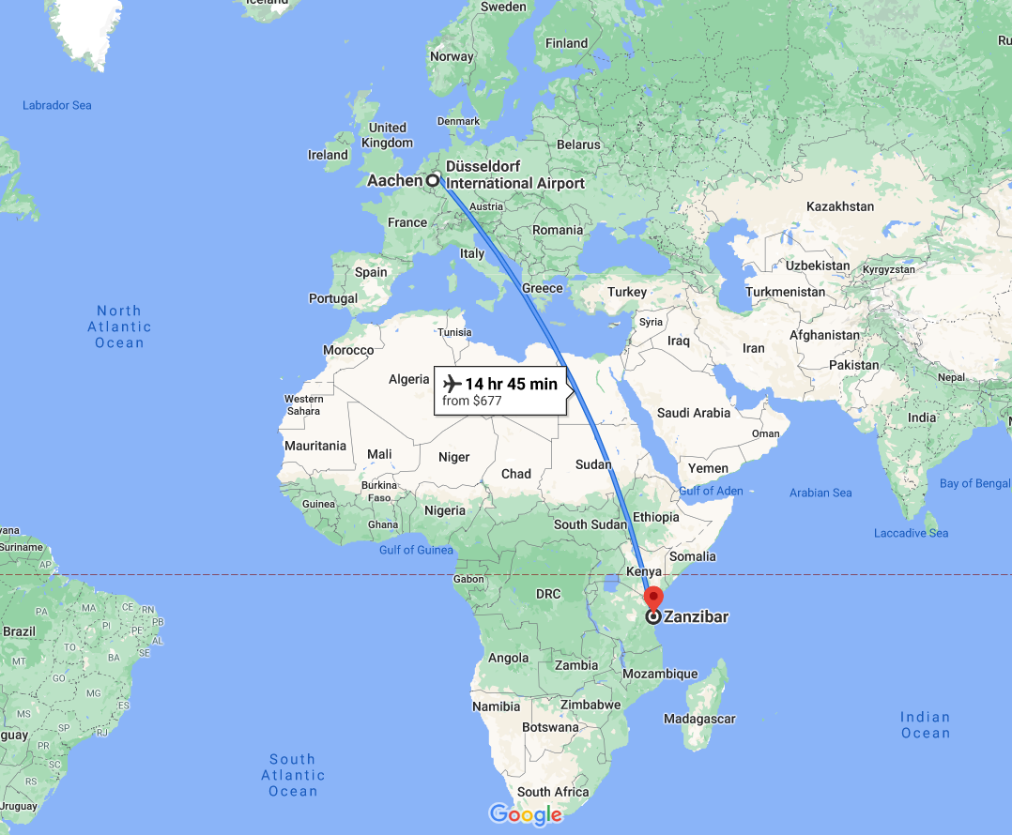
WHERE IS MY BAG? FROM AACHEN TO ZANZIBAR
IN A BAYESIAN NETWORK WE NEED TO SPECIFY THE CONDITIONAL PROBABILITIES OF EACH NODE GIVEN ITS “PARENTS”
Example: Where is my bay?
Two causes for the appearance of a bag on the carousel:
Bag on plane
Elapsed time
Bag on carousel
To turn causal diagram into Bayesian network……
Conditional probability table!

Slide 28
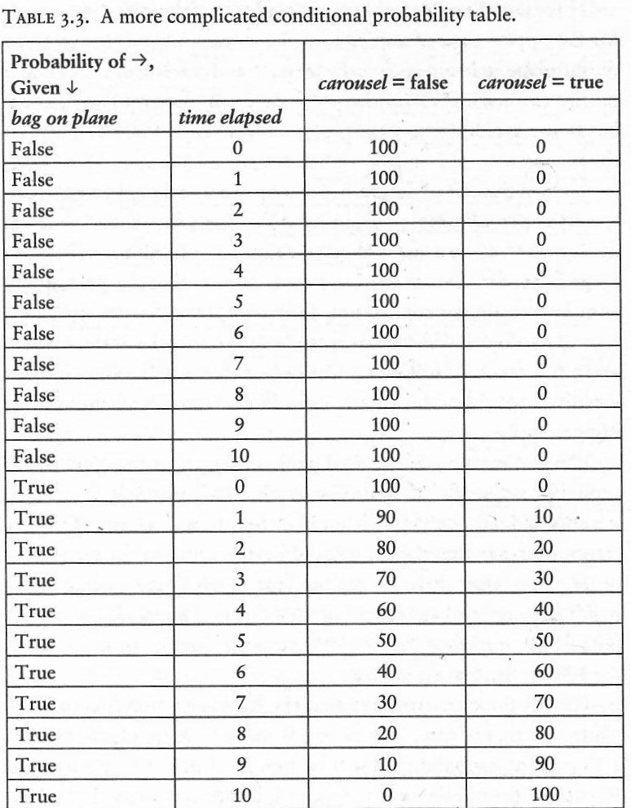
WHERE IS MY BAG? FROM AACHEN TO ZANZIBAR
Forward probabilities
P(bag on plane= true)= 50%
P (carousel=false|bag on plane=false)= 100%

Slide 29
WHERE IS MY BAG? FROM AACHEN TO ZANZIBAR
Forward probabilities
P(bag on plane= true)= 50%
P (carousel=false|bag on plane=false)= 100%
Inverse probability problem…..
If after 1 minute I still cant see my bag on carousel, What is the probability that my bag was on the plane?

Slide 30
WHERE IS MY BAG? FROM AACHEN TO ZANZIBAR
BAYE’S FORMULA
?
P(bag on plane= true| carousel= false) * P(carousel= false)
P (carousel=false|bag on plane=true, time=1)
=
P(bag on a plane= true)

Slide 31
WHERE IS MY BAG? FROM AACHEN TO ZANZIBAR
BAYE’S FORMULA
?
P(bag on plane= true| carousel= false) * P(carousel= false)
P (carousel=false|bag on plane=true, time=1)
=
P(bag on a plane= true)
50 %
Prior probability

Slide 32
WHERE IS MY BAG? FROM AACHEN TO ZANZIBAR
BAYE’S FORMULA
?
P(bag on plane= true| carousel= false) * P(carousel= false)
P (carousel=false|bag on plane=true, time=1)
=
P(bag on a plane= true)
50 %
 | Time | Carousel=false | Carousel=true
Bag on plane=false | 1 | 100 | 0
Bag on plane=true | 1 | 90 | 10

Slide 33
WHERE IS MY BAG? FROM AACHEN TO ZANZIBAR
BAYE’S FORMULA
?
P(bag on plane= true| carousel= false) * P(carousel= false)
P (carousel=false|bag on plane=true, time=1)
=
P(bag on a plane= true)
90 %
50 %
 | Time | Carousel=false | Carousel=true
Bag on plane=false | 1 | 100 | 0
Bag on plane=true | 1 | 90 | 10

Slide 34
WHERE IS MY BAG? FROM AACHEN TO ZANZIBAR
BAYE’S FORMULA
?
P(bag on plane= true| carousel= false) * P(carousel= false)
P (carousel=false|bag on plane=true, time=1)
=
P(bag on a plane= true)
90 %
50 %
 | Time | Carousel=false | Carousel=true
Bag on plane=false | 1 | 100 | 0
Bag on plane=true | 1 | 90 | 10
100
100
190
10
200

Slide 35
WHERE IS MY BAG? FROM AACHEN TO ZANZIBAR
BAYE’S FORMULA
?
95 %
P(bag on plane= true| carousel= false) * P(carousel= false)
P (carousel=false|bag on plane=true, time=1)
=
P(bag on a plane= true)
90 %
50 %
 | Time | Carousel=false | Carousel=true
Bag on plane=false | 1 | 100 | 0
Bag on plane=true | 1 | 90 | 10
100
190
=
95 %
200
100
190
10
200

Slide 36

WHERE IS MY BAG? FROM AACHEN TO ZANZIBAR
BAYE’S FORMULA
?
95 %
P(bag on plane= true| carousel= false) * P(carousel= false)
P (carousel=false|bag on plane=true, time=1)
=
P(bag on a plane= true)
90 %
50 %
90 %
*
50 %
P(bag on plane= true| carousel= false)
47 %
=
$$≅$$
95 %

Slide 37
WHERE IS MY BAG? FROM AACHEN TO ZANZIBAR
P(bag on a plane= true) = 50%

Slide 38
WHERE IS MY BAG? FROM AACHEN TO ZANZIBAR
P(bag on a plane= true) = 50%
P(bag on a plane= true) = 70%

Slide 39
WHERE IS MY BAG? FROM AACHEN TO ZANZIBAR
P(bag on a plane= true) = 50%
P(bag on a plane= true) = 70%
P(bag on a plane= true) = 30%

Slide 40
WHERE IS MY BAG? FROM AACHEN TO ZANZIBAR
Bag on plane
Elapsed time
Two parents and 11 states = 2*11 = 22 parent states
Bag on carousel
Keep the network so that only the most important ones remain and the network is “sparce” to achieve reasonable computational times.
How this could be done without discarding information or variables that have to be present in a causal diagram???
Not all Bayesian Networks are causal.

Slide 41
BAYESIAN NETWORKS IN THE REAL WORLD
Bonaparte DNA-matching software used by the Netherlands Forensic Institute
Convert the pedigree of a family into a Bayesian Network so that the DNA from distant relatives or from multiple relatives could be used to identify a victim.
How? Based on belief propagation with Baye’s rule……as new evidence enter to the network the degrees of belief will change.
At the end, you will end up with a probability for a given victim to match a place in the pedigree.
Error-correction algorithms in cell phones
Encode each message twice, once directly and once after scrambling the message (“Turbo code”)

Slide 42
FROM BAYESIAN NETWORKS TO CAUSAL DIAGRAMS
Main differences:
How they are constructed
- BN are compact representations of a probability table
- CD for a given variable we need to ask which other variables it “listens” to before choosing its value.

Slide 43
FROM BAYESIAN NETWORKS TO CAUSAL DIAGRAMS
Main differences:
How they are constructed
- BN are compact representations of a probability table
- CD for a given variable we need to ask which other variables it “listens” to before choosing its value.
2) Type of question or uses
BN tell us how likely one event is, given that we observed another
CD can answer interventional and counterfactual questions
B
A
C
CD = Changing A would have no effect on C (if we condition on B)
BN = Observed changes in A are associated with changes in C (data alone cannot distinguish a fork from a chain)

Slide 44
FROM BAYESIAN NETWORKS TO CAUSAL DIAGRAMS
Main differences:
How they are constructed
- BN are compact representations of a probability table
- CD for a given variable we need to ask which other variables it “listens” to before choosing its value.
2) Type of question or uses
BN tell us how likely one event is, given that we observed another
CD can answer interventional and counterfactual questions
B
A
C
CD = Changing A would have no effect on C (if we condition on B)
BN = Observed changes in A are associated with changes in C (data alone cannot distinguish a fork from a chain)
Now, we can predict the effect of actions/interventions without doing an experiment

Slide 45
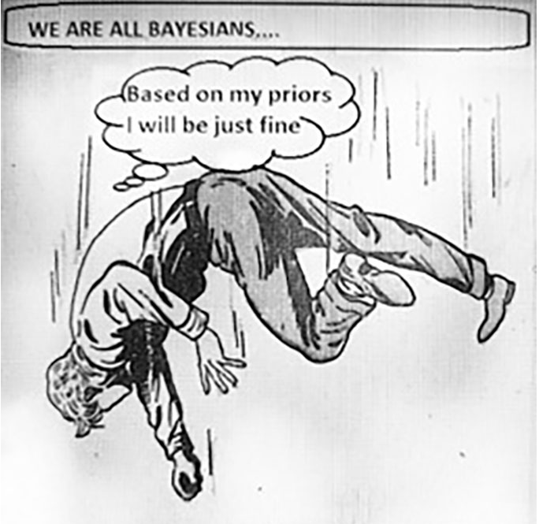
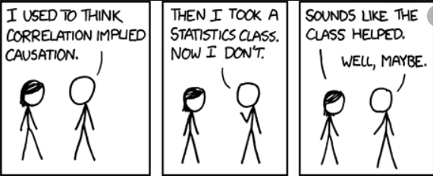
MORE EXAMPLES OF BAYESIAN THINKING……….

